Slide 1
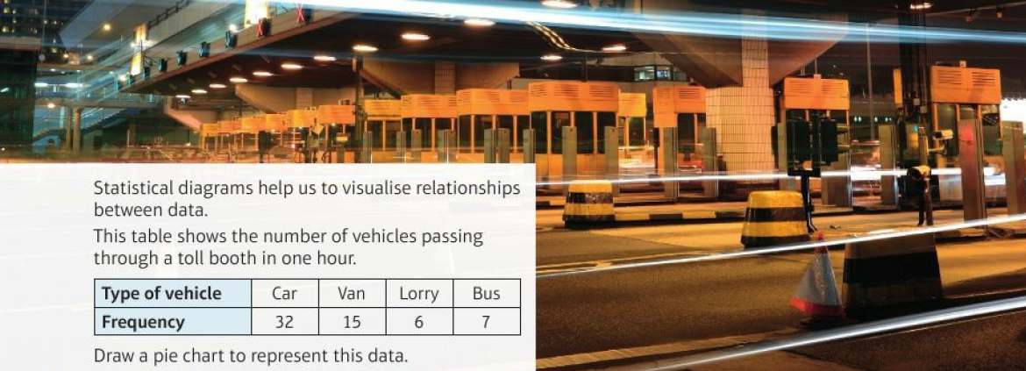
Mathematics (9-1) - iGCSE
2018-20
Year 09
Statistical diagrams help us to visualise relationships between data. This table shows the number of vehicles passing through a toll booth in one hour.
Draw a pie chart to represent this data.
Type of Vehicle | Car | Van | Lorry | Bus
Frequency | 32 | 15 | 6 | 7
Unit 14 – Further Statistics

Slide 2
Contents
Page iv
14 Further statistics 439
Prior knowledge check 439
14.1 Sampling 440
14.2 Cumulative frequency 443
14.3 Box plots 446
14.4 Drawing histograms 449
14.5 Interpreting histograms 450
14.6 Comparing and describing populations 453
Problem-solving: Brain training 456
Checkup 457
Strengthen 458
Extend 463
Knowledge check 466
Unit test 468

Slide 3
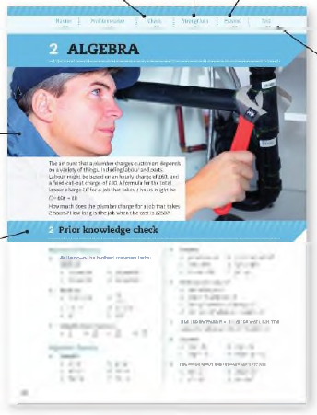
Contents
Page v
At the end of the Master lessons, take a check-up test to help you to decide whether to strengthen or Extend our learning
Extend helps you to apply the maths you know to some different situations
Unit Openers put the maths you are about to learn into a real-life context. Have a go at the question - it uses maths you have already learnt so you should be able to answer it at the start of the unit.
When you have finished the whole unit, a Unit test helps you see how much progress you are making.
Choose only the topics in strengthen thay you need a bit more practice with. You’ll find more hints here to lead you through specific questions. Then move on to Extend
Use the Prior knowledge check to make sure you are ready to start the main lessons in the unit. It checks your knowledge from Key Stage 3 and from earlier in the GCSE course. Your teacher has access to worksheets if you need to recap anything.

Slide 4
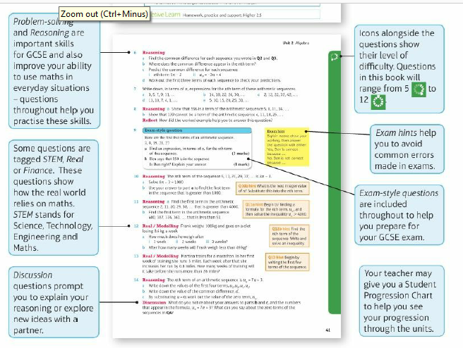
Contents
Page vi

Slide 5
14 – Prior Knowledge Check
Page 439
Numerical fluency
a. Write 32 as a percentage of 640.
Work out 10% of 1120.
Work out 20% of 250.
Divide 30 people in the ratio 1:5.
A group of people is divided in the ratio 2:7. There are 18 people in the smaller group. How many people are there altogether?

Slide 6
14 – Prior Knowledge Check
Page 439
Fluency with data
Classify each of these as categorical, discrete or continuous.
a. The time taken to run 100m
The number of peas in a pod
The colour of cars passing the school gates
The masses of chicks in a nest
The number of days that it rains in a month

Slide 7
14 – Prior Knowledge Check
Page 439
Fluency with data
The masses of 20 badgers are recorded in this table.
Write down the modal class,
Work out an estimate for the mean mass.
Write down the interval that contains the median.
Mass, m (kg) | Frequency
9 < x ≤ 10 | 5
10 < x ≤ 11 | 7
11 < x ≤ 12 | 6
12 < x ≤ 13 | 2

Slide 8
14 – Prior Knowledge Check
Page 439
Fluency with data
Work out the mean, median, mode and range for these data sets,
3, 4, 6, 7, 7
4, 5, 5, 5, 6, 6, 7, 8, 9, 10
2.1, 1.8, 3.2, 4.5, 1.3, 1.8, 5.1, 4.3
* Challenge
The mean of six numbers is 7. The numbers are 3,5,5,10, x and x -1. Work out
the value of x
the median value
the range.
Type of Eggs | 4 | 5 | 6 | 7
Frequency | 3 | 6 | 5 | 2

Slide 9
14.1 – Sampling
Page 440
Objectives |  | Why Learn This?
Understand how to take a simple random sample. Understand how to take a stratified sample. |  | To understand our behaviour, scientists often need to know our opinions. As they can't ask all 7 billion of us, they need to sample us.
Fluency
Simplify $\frac{14}{120}$ ● Find $\frac{3}{20}$ of 400
ActiveLearn - Homework, practice and support: Higher 14.1

Slide 10
14.1 – Sampling
Page 440
Warm Up
The table shows the members of a leisure centre by age group.
How many members are there?
What fraction of the members are in the 20-29 age group?
What percentage of the members are in the 20-49 age group? Give your answer correct to 1 d.p.
Dee asks 10% of the members in the 20-29 age group a question. How many members is this?
Filipe asks 20 members in the 40-49 age group a question. What fraction of the members is this?
Age | Number of Members
11-19 | 120
20-29 | 130
30-39 | 215
40-49 | 120
50+ | 125

Slide 11
14.1 – Sampling
Page 440
Key Point 1
A population is the set of items that you are interested in.
A census is a survey of the whole population.
A sample is a smaller number of items from the population. A sample of at least 10% is considered to be a good-sized sample.
Reasoning John wants to find out about the shopping habits of people in his local town. He wonders whether to ask the first 30 people he sees in the street outside the supermarket,
Is this sample likely to be representative of the population? Explain.
Janna suggests that he pick 30 people at random from the Electoral Roll. Is this sample likely to be representative of the population? Explain.
Discussion Why do surveys often use a sample instead of the whole population?
What factors must researchers consider when deciding on the size of the sample?
Q2a hint - Is every member of the population equally likely to be chosen?

Slide 12
14.1 – Sampling
Page 440
Key Point 2
In order to reduce bias, a sample must - as far as possible - represent the whole population.
Reasoning Explain whether each of these samples is biased.
A medical practice wants to find out patients' opinions of its service. They ask all the people in the waiting room one Friday morning,
You ask 50 people who use a bottle bank what they think of recycling,
A head-teacher asks the first 5 people on the register in each tutor group what they think of the new school logo.
A market research company wants to find out views on a new advertising campaign. It conducts a telephone survey of 2 people in each of 20 towns.

Slide 13
14.1 – Sampling
Page 440
Key Point 3
In a random sample each item has the same chance of being chosen.
To select a simple random sample, draw names from a hat or use a table of random numbers..
Here is a display of random numbers.
Follow these steps to get seven random numbers between 0 and 50. Start with 86 and write the digits in pairs: 86, 13, ... Cross out any over 50 and any repeats. Continue until you have seven numbers.
Use the display to give six random numbers between 0 and 99.
86136078784880569909326 602317798795097905131992…

Slide 14
14.1 – Sampling
Page 441
Example 1
Describe how you could select a random sample of size 15 from a population of 90 people.
List them in alphabetical order of their last names. Number the list from 1 to 90.
Use a calculator to generate 15 random numbers between 1 and 90. Ignore any repeated numbers or numbers greater than 90. Choose these people from the list.
Explain how to list the population.
Explain how to use random numbers to choose the sample from the population list.

Slide 15
14.1 – Sampling
Page 441
Real / Communication A company with 60 employees needs to try out a new flexi-time scheme. It decides on a random sample of 8 employees. Explain how it could use this table of random numbers to select a sample. Write down the numbers of the employees who will be in the sample.
46126712480699241483783765733947..
Key Point 4
A population may divide into groups such as age range or gender. These groups are called strata. In a stratified sample, the number of people taken from each group is proportional to the group size.
Strata is the plural of stratum (meaning 'layer').

Slide 16
14.1 – Sampling
Page 441
Reasoning Jasmine wants to collect some data on the sports enjoyed by members of her local leisure centre. There are 1000 members, 400 of whom are male,
Jasmine wants a sample of 10% of the members. How many members should she ask?
Describe how Jasmine could select a simple random sample. She decides to ask 50 males picked at random and 50 females picked at random,
What percentage of the males a re selected?
What percentage of the females are selected?
Discussion Is she right to ask the same number of males and females? Explain your answer.

Slide 17
14.1 – Sampling
Page 441
The table shows the number of students in each school year,
Alfie chooses a sample of 100 students. Show that this is 10% of the total number of students.
Work out 10% of each year group,
Show that taking 10% of each year group gives a sample of 100 students in total.
Year | Number of students
7 | 210
8 | 190
9 | 180
10 | 200
11 | 220
Q7a hint - Work out the total number of students.

Slide 18
14.1 – Sampling
Page 442
Communication A sports dub manager wants to find out what the members think of the new changing room facilities. There are 350 women and 450 men in the dub.
Explain why a stratified sample should be used,
The manager wants to survey 10% of the members. How many women and how many men should be asked?
The club decides to ask 48 members. How many of each gender should it ask?
Q8c hint - Work out the sample size as a percentage of the total number of
Members.
$\frac{48}{□}$ = $□$%

Slide 19
14.1 – Sampling
Page 442
9 – Exam-Style Questions
A school has 450 students.
Each student studies on e of Greek or Spanish or German or French. The table shows the number of students who study each of these languages. An inspector wants to look at the work of a stratified sample of 70 of these students.
Find the number of students studying each of these languages that should be in the sample. (3 marks)
Nov 2006, Q15, 5525/06J
Language | Number of Students
Greek | 45
Spanish | 121
German | 98
French | 186
Exam hint
Show all your calculations clearly. You could add columns to the table

Slide 20
14.1 – Sampling
Page 442
STEM / Problem-solving A scientist wishes to find out how many fish are in a lake. He catches 40 fish and marks them with a small tag. Two weeks later, he returns to the lake and catches another 40 fish. Five of the fish he catches have been marked with his tag.
What fraction of the fish he catches in the second sample are tagged?
Assume the fraction tagged in the sample is the same as the fraction tagged in the lake.
Estimate how many fish are in the lake.
Q10b hint - Let/be the number of fish in the lake. Write an expression for the fraction of tagged fish in the lake.

Slide 21
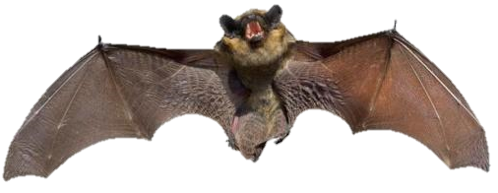
14.1 – Sampling
Page 442
STEM / Problem-solving A naturalist captures 30 bats in a cave and tags them. There are approximately 600 bats in the colony. The naturalist returns a month later and captures 40 bats. How many would she expect to find tagged?.

Slide 22
14.2 – Cumulative Frequency
Page 443
Objectives |  | Why Learn This?
Draw and interpret cumulative frequency tables and diagrams. Work out the median, quartiles and interquartile range from a cumulative frequency diagram. |  | Having a 'running total' of data helps you work out how many data values are less than or greater than a given number.
Fluency
How many lengths of wood are less than or equal to 5 m long less than or equal to 10m long more than 5m long?
Length of wood, / (m) | Frequency
0 ≤ l ≤ 5 | 4
5 < l ≤ 8 | 6
8 < l ≤ 10 | 7
ActiveLearn - Homework, practice and support: Higher 14.2

Slide 23
14.2 – Cumulative Frequency
Page 443
For 11,14,15,16,18, 21, 22,25,26,27,30
write down the median
which value is
¼ of the way into the list
¾ of the way into the list?
Warm Up
Key Point 6
A cumulative frequency table shows how many data values are less than or equal to the upper class boundary of each data class.
The upper class boundary is the highest possible value in each class.

Slide 24
14.2 – Cumulative Frequency
Page 443
The frequency table shows the masses of 50 cats. Copy and complete the cumulative frequency table.
Mass, m (kg) | Frequency
3 < m ≤ 4 | 4
4 < m ≤ 5 | 12
5 < m ≤ 7 | 17
6 < m ≤ 7 | 10
7 < m ≤ 8 | 7
Mass, m (kg) | Cumulative Frequency
3 < m ≤ 4 | 4
4 < m ≤ 5 | 4 + 12 = □
5 < m ≤ 7
6 < m ≤ 7
7 < m ≤ 8
Key Point 1
A cumulative frequency diagram has data values on the x-axis and cumulative frequency on the y-axis.

Slide 25
14.2 – Cumulative Frequency
Page 443
STEM This frequency table gives the heights of 70 giraffes. Draw a cumulative frequency table for this data.
Height, h (m) | Frequency
4.0 < m ≤ 4.2 | 2
4.2 < m ≤ 4.4 | 3
4.4 < m ≤ 4.6 | 5
4.6 < m ≤ 4.8 | 8
4.8 < m ≤ 5.0 | 12
5.0< m ≤ 5.2 | 18
5.2< m ≤ 5.4 | 15
5.4< m ≤ 5.6 | 7
Q3 hint - Start every height group with the shortest height given in the table: 4.0 < h ≤ 4.2, 4.0 < h ≤ 4.4, etc.

Slide 26
14.2 – Cumulative Frequency
Page 444
Example 2
The cumulative frequency table shows the amount of pocket money for 40 teenagers,
Draw a cumulative frequency diagram,
Use the cumulative frequency diagram to find an estimate for the median amount of pocket money,
Estimate the range.
Pocket Money, x (£) | Cumulative Frequency
0 ≤ m ≤ 1 | 2
1 ≤ m ≤ 2 | 8
2 ≤ m ≤ 3 | 19
3 ≤ m ≤ 4 | 32
4 ≤ m ≤ 5 | 39
5 ≤ m ≤ 6 | 40

Slide 27
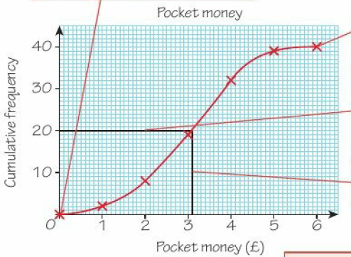
14.2 – Cumulative Frequency
Page 444
Example 2 - Answer
Plot (0,0).There are no people with less than £0 pocket money.
Plot each frequency at the upper class boundary: (1,2), (2,8), etc. Draw a smooth curve through the points.
An estimate for the median is £3.10.
Lowest possible value = £0 Highest possible value = £6 An estimate for the range = 6-0 = £6
To find the median, draw a line from the halfway cumulative frequency value.
Draw a line down to the x-axis and read off the value.
The lowest possible value is the lower class boundary of the lowest class.
The highest possible value is the upper class boundary of the highest class.

Slide 28
14.2 – Cumulative Frequency
Page 444
4 – Exam-Style Questions
Time, t (mins) | Frequency
0 < m ≤ 4 | 3
2 < m ≤ 5 | 12
4 < m ≤ 7 | 19
6 < m ≤ 7 | 10
8 < m ≤ 8 | 6
This table gives the times taken by 50 students to solve a maths puzzle. Draw a cumulative frequency diagram. (2 marks)
Use the diagram to find an estimate for the median time taken. (1 mark)
Estimate the range. (2 marks)
Exam hint
Remember to label both axes and plot your points at the top of the interval.
Discussion Why are your values for the median and range estimates?

Slide 29
14.2 – Cumulative Frequency
Page 444
STEM
Draw a cumulative frequency diagram for the giraffe data in Q3.
Find an estimate for the median height of the giraffes.
Key Point 8
For a set of n data values on a cumulative frequency diagram
the estimate for the lower quartile (LQ) is the $\frac{n}{4}$ th value
the estimate for the upper quartile (UQ) is the $\frac{3n}{4}$th value
the interquartile range (IQR) = UQ - LQ

Slide 30
14.2 – Cumulative Frequency
Page 445
The time taken for 80 runners to complete a 10-kilometre fun run is shown in the table,
Draw a cumulative frequency diagram,
Estimate the median time taken,
Estimate the lower quartile of the time taken.
Estimate the upper quartile.
Use your answers to parts c and d to work out an estimate for the interquartile range.
Time, t (mins) | Frequency
40 < t ≤ 45 | 3
45 < t ≤ 50 | 17
50 < t ≤ 55 | 25
55 < t ≤ 60 | 26
60 < t ≤ 65 | 8
65 < t ≤ 70 | 1
Q6c hint - Draw a line across to the curve from the cumulative frequency value one quarter of the way up, then down to the x-axis..

Slide 31
14.2 – Cumulative Frequency
Page 445
STEM / Reasoning The table shows the masses of 60 hippos.
Draw a cumulative frequency diagram.
Estimate the median, quartiles and interquartile
Estimate how many hippos weigh less than 1.55 tonnes.
Copy and complete: 40 hippos are estimated to weigh less than _______ tonnes.
Discussion What assumption have you made that could affect your answers to parts c and d?
Mass, m (tonnes) | Frequency
1.3 < m ≤ 1.4 | 4
1.4 < m ≤ 1.5 | 7
1.5 < m ≤ 1.6 | 21
1.6 < m ≤ 1.7 | 18
1.7 < m ≤ 1.8 | 10
Q6c hint - Draw a line to the curve from 1.55 on the x-axis. Read off the cumulative frequency axis.

Slide 32
14.2 – Cumulative Frequency
Page 445
8 – Exam-Style Questions
Charlie drives to work.
The table gives information about the time (t minutes) it took him to get to work on each of 100 days.
Draw a cumulative frequency table. (1 mark)
Draw a cumulative frequency diagram. (2 marks)
Use your diagram to find an estimate of the median time. (1 mark)
Use your diagram to find an estimate for the number of days it took Charlie more than 18 minutes to drive to work. (2 marks)
Time, t (minutes) | Frequency
0 < t ≤ 10 | 16
10 < t ≤ 20 | 34
20 < t ≤ 30 | 32
30 < t ≤ 40 | 14
40 < t ≤ 50 | 4
Exam hint
For parts c and d draw lines on the diagram with a ruler to show how you got your answers.

Slide 33
14.3 – Box Plots
Page 443
Objectives |  | Why Learn This?
Find the quartiles and the interquartile range from stem-and-leaf diagrams. Draw and interpret box plots. |  | Simple diagrams help us to interpret and compare data.
Fluency
In a set of 50 data values, which value is the median? The upper quartile is 26 and the lower quartile is 10. What is the interquartile range?
ActiveLearn - Homework, practice and support: Higher 14.3

Slide 34
14.3 – Box Plots
Page 446
The stem-and-leaf diagram gives the ages of the members of a judo club. Key: 3 | 7 represents 37 years
Find the median age.
Work out the range.
Warm Up
1 3 5 8 8
2 0 1 2 5 6 6 7 9
1 7
4 0 5
5 1

Slide 35
14.3 – Box Plots
Page 446
Key Point 9
A box plot, sometimes called a box-and- whisker diagram, displays a data set to show the median and quartiles. Summary statistics for a set of data are the averages, ranges and quartiles.
Example 3
The table shows summary statistics from a data set of the lengths of ladybirds. Draw a box plot for the data.
Minimum | Lower Quartile | Median | Upper Quartile | Maximum
3mm | 5mm | 8mm | 9mm | 11mm

Slide 36
14.3 – Box Plots
Page 446
Draw a box plot for this data on the masses of tomatoes.
Minimum | LQ | Median | UQ | Maximum
120g | 135g | 140g | 150g | 154g
Q2 hint - LQ = lower quartile UQ = upper quartile
Key Point 10
For a set of n data values
the lower quartile (LQ) is the $\frac{n+1}{4}$th value
the upper quartile (UQ) is the $\frac{3(n+1)}{4}$th value

Slide 37
14.3 – Box Plots
Page 447
Reasoning This data shows the length of time, in minutes, it took 11 students to complete an essay. 15, 18,19,21,22,25, 26, 26,28,30,31
Write down the median time taken.
Find the upper and lower quartiles.
Draw a box plot for the data.
Discussion Why do you use the $\frac{n+1}{4}$th data value for the lower quartile in a data set but the $\frac{n}{4}$th value in a cumulative frequency diagram?

Slide 38
14.3 – Box Plots
Page 447
Reasoning This stem-and-leaf diagram shows the ages of 37 people on a bus.
What age was the youngest passenger?
What is the median age?
Find the lower and upper quartiles of the ages,
Work out the interquartile range,
Draw a box plot.
1 | 6 | 7 | 9 | 9
2 | 1 | 2 | 2 | 4 | 6 | 7 | 8
3 | 3 | 6 | 6 | 7 | 8 | 9 | 9
4 | 0 | 0 | 1 | 3 | 4 | 5 | 8 | 8 | 9 | 9
5 | 0 | 1 | 2 | 4 | 4 | 5 | 6 | 7 | 9

Slide 39
14.3 – Box Plots
Page 447
This data shows the heights, in metres, of 15 trees. 4.5, 5.3, 11, 4.8, 6.1,10.2, 5.8, 7.3, 8, 9.6, 6.3, 8.8, 4.9, 6, 8 Draw a box plot for the data.
Key Point 11
Comparative box plots are box plots for two different sets of data drawn in the same diagram.

Slide 40
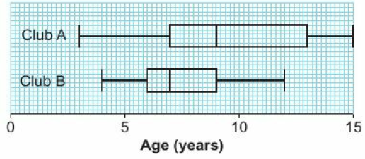
14.3 – Box Plots
Page 447
The ages of children in two different after-school dubs are shown in the comparative box plots.
Ages of children in after-school clubs
Which club had the higher median age?
Work out the interquartile range for each club,
Work out the range for each club.

Slide 41
14.3 – Box Plots
Page 447
Reasoning – Summary statistics on the masses, in grams, if two different species of birds are given in this table.
Draw comparative box plots for these two species.
Compare the two species.
 | Minimum | LQ | Median | UQ | Maximum
Species A | 45 | 52 | 60 | 65 | 69
Species B | 33 | 44 | 65 | 77 | 90
Q7a hint – Use the same scale and draw one box plot above the other.
Q7b hint – Compare the medians, interquartile ranges and ranges.

Slide 42
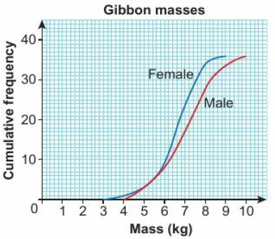
14.3 – Box Plots
Page 448
STEM /Reasoning The cumulative frequency graph gives information about the masses, in kilograms, of 36 male and 36 female gibbons.
Use the graph to find the median and quartiles for each gender,
Draw comparative box plots for the two genders.
Compare the two genders.

Slide 43
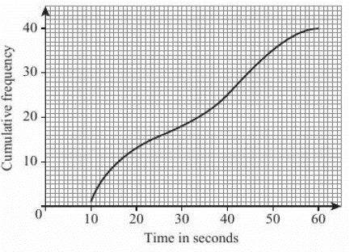
14.3 – Box Plots
Page 448
9 – Exam-Style Questions
40 boys each completed a puzzle.
The cumulative frequency graph gives information about the times it took them to complete the puzzle.
Use the graph to And an estimate for the median time. (1 mark)

Slide 44
14.3 – Box Plots
Page 448
9 – Exam-Style Questions
For the boys the minimum time to complete the puzzle was 9 seconds and the maximum time to complete the puzzle was 57 seconds,
Use this information and the cumulative frequency graph to draw a box plot showing information about the boys' times. Use a scale like this: (3 marks)
The box plot right shows information about the times taken by 40 girls to complete the same puzzle.
Make two comparisons between the boys’ times and the girls’ times. (2 marks)
June 2004, Q13, 5505/05

Slide 45
14.4 – Drawing Histograms
Page 449
Objectives |  | Why Learn This?
Understand frequency density. Draw histograms. |  | Bar charts and frequency diagrams show data grouped in equal class intervals. For data grouped in unequal class intervals, you need a histogram.
Fluency
Work out: 32 ÷ 10 ● 158 ÷ 20 ● 30 ÷ 0.2 ● 8 ÷ 0.05
ActiveLearn - Homework, practice and support: Higher 14.4

Slide 46
14.4 – Drawing Histograms
Page 449
Warm Up
The masses of 101 birds are recorded in a table.
Draw a frequency diagram for the data,
Write down the modal class.
Calculate an estimate of the mean mass.
Work out the frequency density for each class in Q1.
Mass, m (grams) | 10 < m ≤ 12 | 12 < m ≤ 14 | 14 < m ≤ 16 | 16 < m ≤ 18 | 18 < m ≤ 20
Frequency | 11 | 23 | 31 | 20 | 16
Key Point 12
In a histogram the area of the bar represents the frequency. The height of each bar is the frequency density.
Frequency density = $\frac{Frequency}{Class Width}$

Slide 47
14.4 – Drawing Histograms
Page 449
The heights of 70 trees are recorded in this table,
Work out each class width,
Work out the frequency density for each class.
Height h (metres) | Frequency | Class Width | Frequency Density
20 < h ≤ 25 | 8 | 5 | $\frac{8}{5}$ = 1.6
25 < h ≤ 30
30 < h ≤ 35
35 < h ≤ 40

Slide 48
14.4 – Drawing Histograms
Page 449
Example 4
The lengths of 48 worms are recorded in this table. Draw a histogram to display this data.
6 ÷ 5 = 1.2, 14 ÷ 10 = 1.4, 26 ÷ 10 = 2.6, 2 ÷ 20 – 0.1
Length, x (mm) | 15 < x ≤ 20 | 20 < x ≤ 30 | 30 < x ≤ 40 | 40 < x ≤ 60
Frequency | 6 | 14 | 26 | 2
Work out the frequency density for each class.

Slide 49
14.4 – Drawing Histograms
Page 450
This table shows the times taken for 55 runners to complete a fun run. Draw a histogram for this data.
This table contains data on the heights of 76 students. Draw a histogram for this data.
Time, t (mins) | 40 < t ≤ 45 | 45 < t ≤ 50 | 50 < t ≤ 60 | 60 < t ≤ 80
Frequency | 4 | 17 | 22 | 12
Height, h (m) | 1.5 < h ≤ 1.52 | 1.52 < h ≤ 1.55 | 1.55 < x ≤ 1.60 | 1.60 < h ≤ 1.65 | 1.65 < h ≤ 1.80
Frequency | 4 | 18 | 25 | 15 | 14
Exam hint
Use the midpoint of each class interval.

Slide 50
14.4 – Drawing Histograms
Page 450
6 – Exam-Style Questions
Fred did a survey on the areas of pictures in a newspaper. The table gives information about the areas.
Work out an estimate for the mean area of a picture. (4 marks)
Draw a histogram for the information given in the table. (3 marks)
Nov 2005, Q10, 5525/06J
Area, A (cm²) | Frequency
0 < A ≤ 10 | 38
10 < A ≤ 25 | 36
25 < A ≤ 40 | 30
40 < A ≤ 10 | 46
Exam hint
Use the midpoint of each class interval.

Slide 51
14.5 – Interpreting Histograms
Page 449
Objectives |  | Why Learn This?
Interpreting histograms. |  | Reading accurately from statistical diagrams is important to draw accurate conclusions.
Fluency
What fraction of a set of data is greater than the median?
ActiveLearn - Homework, practice and support: Higher 14.4

Slide 52
14.5 – Interpreting Histograms
Page 450
The masses of 80 apples are recorded in a table.
Work out an estimate for the mean mass,
Find the class interval that contains the median.
Warm Up
Mass, m (grams) | 100 < m ≤ 110 | 110 < h ≤ 120 | 120 < x ≤ 130 | 130 < h ≤ 140
Frequency | 16 | 22 | 29 | 13

Slide 53
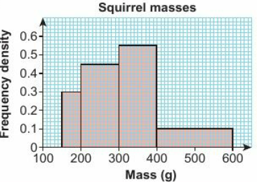
14.5 – Interpreting Histograms
Page 450
STEM / Reasoning The histogram shows the masses of a number of squirrels.
How many squirrels weigh between 150 grams and 200 grams?
How many squirrels weigh between 200 grams and 400 grams?
How many squirrels are there in total? Discussion What does the area of the bar on the histogram tell you?

Slide 54
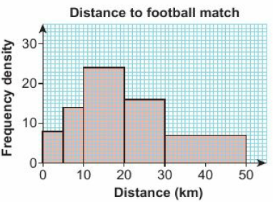
14.5 – Interpreting Histograms
Page 451
Reasoning The histogram shows the distance a group of football fans have to travel to a match.
How many fans travelled less than 5 km?
Estimate how many fans travelled less than 15 km.
Estimate how many fans travelled between 25 and 32 km.
Q3b hint - How many fans travelled between 10 and 15 km?

Slide 55
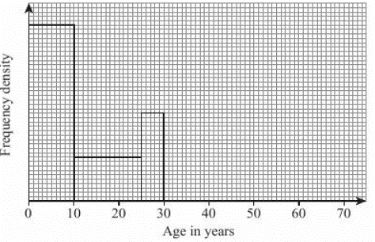
14.5 – Interpreting Histograms
Page 451
14 – Exam-Style Questions
The incomplete table and histogram give some information about the ages of the people who live in a village.
Use the information in the histogram to complete the frequency table below. (2 marks)
Complete the histogram. (2 marks)
June 2003, Q19, 5505/05
Age (x) in years | Frequency
0 < x ≤ 10 | 160
10 < x ≤ 25
25 < x ≤ 30
30 < x ≤ 40 | 100
40 < x ≤ 70 | 120

Slide 56
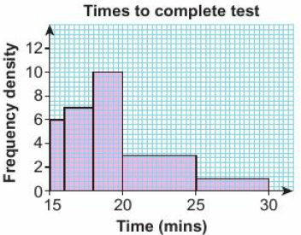
14.5 – Interpreting Histograms
Page 451
Problem-solving The histogram shows the times taken for a number of students to complete an arithmetic test,
Draw a grouped frequency table for the data,
Work out an estimate for the mean time taken,
How many students took longer than 19 minutes to complete the test?
Work out an estimate for the median of the data in Q4.

Slide 57
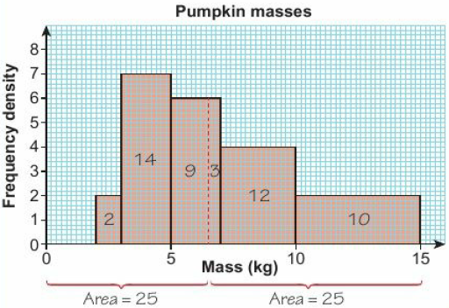
14.5 – Interpreting Histograms
Page 452
Example 5
The histogram shows the masses of pumpkins in a farm shop.
Work out an estimate for the median mass.
Total frequency = 1 x 2 + 2 x 7 + 2 x 6 + 3 x 4 + 5 x 2 = 50
The median lies in the 25.5th value and lies in the class 5 < m ≤ 7
Frequency = area = 9, frequency density = 6
Class width = 9 ÷ 6 = 1.5
An estimate for the median is 5 + 1.5 6,5kg
Work out the areas of all the bars to find the total frequency.
Work out which class contains the median
Use frequency density = $\frac{frequency}{class width}$ to find class width of class from 5 to median.
Add the class width to the lower class boundary.

Slide 58
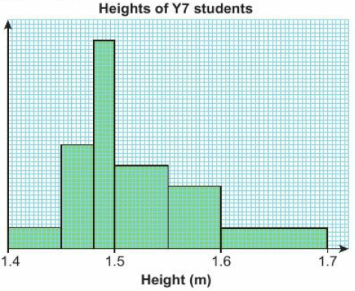
14.5 – Interpreting Histograms
Page 452
Reasoning The histogram shows the heights of Year 7 students.
Five Year 7 students are between 1.4metres and 1.45metres tall. Work out the frequency density for that class,
How many Year 7 students are there in total?
Work out an estimate for the median height,
Draw a frequency table for the data in the histogram,
Work out an estimate for the mean height from your frequency table,
How many of the students are taller than the mean height?
Q7 hint - Label the frequency density scale.

Slide 59
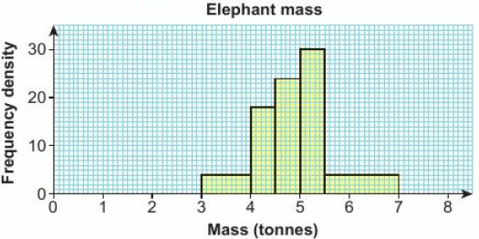
14.5 – Interpreting Histograms
Page 452
Problem-solving The histogram shows the masses of some elephants.
How many elephants are there in total?
Work out an estimate of the median mass,
Estimate how many elephants weigh more than 5.2 tonnes.
Q8 hint To estimate the median, first find the class containing the median mass.

Slide 60
14.6 – Comparing and Describing Populations
Page 453
Objectives |  | Why Learn This?
Compare two sets of data. |  | Market research companies analyse our responses to surveys and look for differences between genders and age groups.
Fluency
What are the measures of • spread • average?
ActiveLearn - Homework, practice and support: Higher 14.4

Slide 61
14.6 – Comparing and Describing Populations
Page 453
Work out the mean, median, mode and range for these sets of data,
1.2, 1.3, 1.4, 1.5, 1.5 b. 4, 5, 6, 4, 3, 6, 7, 8, 3, 3
STEM The table gives the masses, in kilograms, of male and female giant tortoises.
Work out the mean mass for each gender,
Write down the range of masses for each gender.
Warm Up
Male | 280 | 283 | 288 | 290 | 292 | 299 | 300 | 305 | 310
Female | 260 | 261 | 263 | 265 | 269 | 270 | 271 | 273 | 274

Slide 62
14.6 – Comparing and Describing Populations
Page 453
Key Point 13
The interquartile range measures the spread of the middle 50% of the data.
To describe a data set (or population) give a measure of average and a measure of spread. To compare data sets, compare a measure of average and a measure of spread.
STEM Compare the masses of the two genders of tortoise in Q2.
STEM The heights, in centimetres, of female African and Asian elephants are shown in the table.
Describe the heights of these two populations of elephants,
Compare the heights of the two species.
Q4a hint - Use the median and the interquartile range.
African | 270 | 275 | 281 | 286 | 290 | 292 | 295
Asian | 220 | 221 | 223 | 224 | 226 | 227 | 229

Slide 63
14.6 – Comparing and Describing Populations
Page 454
Reasoning Ten male and ten female cyclists compete in a road race. The times, in minutes, to complete the course are recorded. Males: 68, 70, 75, 76, 77, 79, 81, 83, 90, 120 Females: 71, 75, 76, 78, 83, 86, 89, 90, 91, 92
Explain which of the median and interquartile range or mean and range should be used to describe each set of data,
Compare the times for males and females.
Key Point 14
The median and interquartile range are not affected by extreme values or outliers.

Slide 64
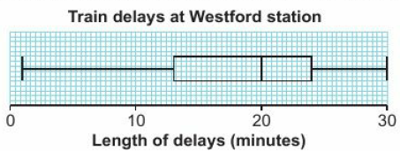
14.6 – Comparing and Describing Populations
Page 454
Real / Problem-solving The table shows the lengths of delays to trains at Stratfield station.
Draw a cumulative frequency diagram,
Find the median and interquartile range.
The box plot shows the delays to trains at Westford station.
Compare the lengths of delays at the two stations.
Length of delay, l (minutes) | Frequency
0 < x ≤ 5 | 4
5 < x ≤ 10 | 7
10 < x ≤ 15 | 12
15 < x ≤ 20 | 6
20 < x ≤ 25 | 2

Slide 65
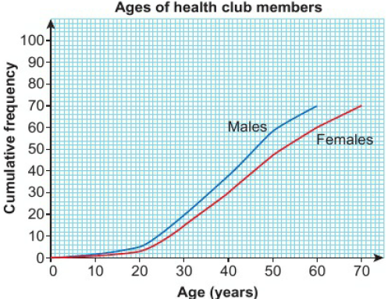
14.6 – Comparing and Describing Populations
Page 455
Problem-solving The cumulative frequency graph shows the ages of male and female members of a health club. Compare the two sets of data.

Slide 66
14.6 – Comparing and Describing Populations
Page 454
Real / Problem-solving This back-to-back stem-and-leaf diagram shows the average speeds, in miles per hour, of cars passing two checkpoints. Key: 5 | 2 | 3 represents 25 mph and 23 mph
Describe the speeds at the two check points,
Compare the speeds at the two checkpoints.
Q8 strategy hint - Compare the medians and interquartile ranges.
 |  | 1 | 2 | 3 | 8 | 1
 |  | 1 | 2 | 4 | 5 | 2 | 3 | 4 | 6 | 8
1 | 2 | 2 | 4 | 5 | 6 | 3 | 3 | 1 | 4 | 5 | 6 | 6 | 7 | 9 | 9
 |  | 2 | 3 | 4 | 5 | 4 | 1 | 2 | 2 | 2 | 3 | 4 | 6 | 7 | 8
 |  |  |  | 1 | 2 | 5

Slide 67
14.6 – Comparing and Describing Populations
Page 455
10 – Exam-Style Questions
Amount spent, x (£) | Cumulative Frequency
0 < x ≤ 10 | 9
0 < x ≤ 20 | 20
0 < x ≤ 30 | 34
0 < x ≤ 40 | 51
0 < x ≤ 50 | 68
0 < x ≤ 60 | 80
Chloe did a survey on the amount of money that men spent shopping each week. The cumulative frequency table shows her results.
A similar survey of women gave a median of £42 and an interquartile range of £12.
Compare the amounts of money spent by women with the amounts spent by men. (5 marks)
Exam hint - Draw a cumulative frequency diagram for the results given in the table.

Slide 68
14 – Problem Solving – Brain Training
Page 456
Objectives | Produce and interpret box plots from lists of data and grouped data. Compare distributions and make inferences.
A company wishes to investigate the effectiveness of their brain training software. They test how long it takes a group of teenagers to solve a logical puzzle, allow them to use the software for a week, and then test them again. Next are the results (A), giving the times in seconds.
Draw a pair of parallel box plots to display these results.
Compare the two distributions. Did the brain training work? Did it have the same effect on everyone?
Q1 hint - Parallel box plots are drawn using the same axis.
Q2 hint - Look at how the median, the quartiles and the minimum and the maximum have each changed.

Slide 69
14 – Problem Solving – Brain Training
Page 456

Slide 70
14 – Problem Solving – Brain Training
Page 456
The company decides to repeat the investigation with adults, using a larger sample size.
Their results (B) are given in the table previously.
Use an appropriate method to estimate the maximum., minimum, median and quartiles of these data sets.
Draw another pair of parallel box plots to display these two new sets of results. Comment on the two 'adult' distributions.
Compare and contrast all four sets of data. Does the company's brain training software work?
Q3 hint - You might find it useful to draw another type of graph first to help you estimate the median and quartiles from grouped data.

Slide 71
14 – Check Up
Page 457
14. Check up | Log how you did on your Student Progression Chart
Sampling
Jaden wants to take a stratified sample of size 80 from the students in his school.
How many of each year group should he ask?
He has a numbered list of all the students in Year 7. Use the display of random numbers to write down the numbers of the first five students that he should ask.
Year | 7 | 8 | 9 | 10 | 11
Students | 320 | 360 | 280 | 340 | 300
1122883981521185753429191255289138004761..

Slide 72
14 – Check Up
Page 457
Graphs and charts
This table shows the masses of 90 emperor penguins,
Draw a cumulative frequency table,
Draw a cumulative frequency graph,
Use your graph to estimate the median mass of the penguins.
Find the lower quartile, upper quartile and interquartile range.
Estimate how many penguins weigh
less than 36 kg
more than 30 kg.
Mass, m (kg) | Frequency
20 < x ≤ 23 | 1
23 < x ≤ 26 | 4
26 < x ≤ 29 | 8
29 < x ≤ 32 | 21
32 < x ≤ 35 | 32
35 < x ≤ 38 | 18
38 < x ≤ 41 | 6

Slide 73
14 – Check Up
Page 457
Graphs and charts
The heights of 100 pine trees are given in this table.
Draw a histogram for this data,
Estimate how many trees are taller than 23 m.
Height, h (m) | Frequency
0 < h ≤ 10 | 3
10 < h ≤ 15 | 7
15 < h ≤ 20 | 14
20 < h ≤ 25 | 31
25 < h ≤ 30 | 27
30 < h ≤ 35 | 16
35 < h ≤ 40 | 2

Slide 74
14 – Check Up
Page 458
Comparing data
The stem-and-leaf diagram shows the ages of people attending a birthday party at a hotel. Key: 1 | 2 represents 12 years
What is the median age?
Work out the interquartile range.
At a second party, the median age was 22 and the interquartile range was 10. Compare the two distributions.
0 | 3 | 5 | 6 | 8 | 9
1 | 2 | 2 | 5 | 8 | 8 | 9
2 | 1 | 3 | 6 | 6 | 7 | 8 | 8 | 9 | 9
3 | 2 | 4 | 4 | 5 | 6 | 6 | 7
4 | 1 | 1 | 4 | 5 | 5 | 8
5 | 4 | 7

Slide 75
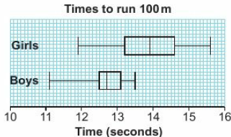
14 – Check Up
Page 457
The box plots show the times for 15 boys and 15 girls to run 100 m. Compare the two distributions.
How sure are you of your answers? Were you mostly Just guessing ☹ Feeling doubtful 😐 Confident ☺ What next? Use your results to decide whether to strengthen or extend your learning.

Slide 76
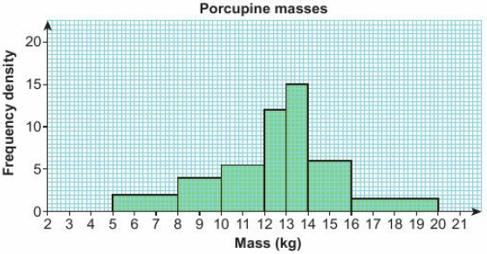
14 – Check Up
Page 458
* Challenge
The histogram shows the masses of a group of porcupines. Estimate how many porcupines weigh between 8.5kg and 16.5kg.

Slide 77
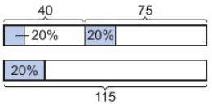
14 – Strengthen
Page 458
14. Strengthen
Sampling
The membership of a hockey club is 75 men and 40 women,
The club manager wants to know members' views on the proposed new kit. Should she ask A the same number of men and women B more men than women C more women than men?
She wants to survey 20% of the members. Work out
20% of 75 ii. 20% of 40.
There are 115 club members. Work out 20% of 115.
What do you notice about your answers to parts b and c?
Q1a hint - Consider the number of men and women in the club.

Slide 78
14 – Strengthen
Page 459
Sampling
Ellen wants to take a stratified sample of the people at her youth club. The table shows the ages of the members.
She wants to ask a sample of 24 people. What is the total number of people?
What percentage sample is 24 people?
Work out this percentage of each age group.
Age | 13 | 14 | 15 | 16 | 17
Number of People | 16 | 28 | 32 | 24 | 20
Q2b hint - $\frac{24}{◻}$ = $◻$%
Q2c hint – Check that your answers add up to 24.

Slide 79
14 – Strengthen
Page 459
Use this random number display to select five people from a list of 30 people.
Write the list as a sequence of two-digit numbers,
Cross out the numbers over 30.
Cross out any repeats.
Write down, in order, the numbers of the people who are chosen.
027921512108015701873373177018402124206662…
Q3a hint – The list starts at 02, 79 …
Q3d hint – 01 represents the first person on the list

Slide 80
14 – Strengthen
Page 459
Use the random number table from Q3 to select a random sample of eight people from a list of 70 people.
Use the random number table from Q3 to select a random sample of five people from a list of 130 people.
Q4 hint – Cross out all numbers over 70
Q5 hint – Write the random numbers as 3-digit numbers.

Slide 81
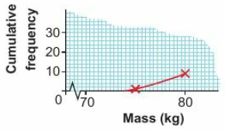
14 – Strengthen
Page 459
Graphs and charts
The table shows the masses of 60 sheep.
Copy and complete the cumulative frequency table
Copy and complete the cumulative frequency graph.
Mass, m (kg) | Frequency
70 < m ≤ 75 | 1
75 < m ≤ 80 | 8
80 < m ≤ 85 | 19
85 < m ≤ 90 | 15
90 < m ≤ 95 | 10
95 < m ≤ 100 | 7
Mass, m (kg) | Cumulative Frequency
70 ≤ m ≤ 75 | 1
70 < m ≤ 80 | 1 + 8 = ◻
70 < m ≤ 85
70 < m ≤ 90
70 < m ≤ 95
70 < m ≤ 100
Q3 hint - Plot the top value in each class against frequency. Draw a smooth curve through the points.

Slide 82
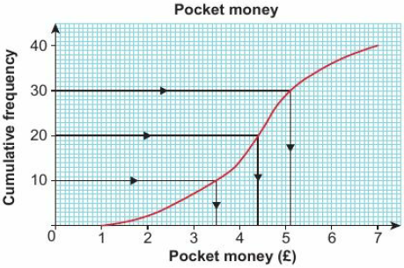
14 – Strengthen
Page 460
The cumulative frequency graph shows information about the amount of pocket money 40 children receive.
Read off the values for the median, lower quartile and upper quartile.
Work out the interquartile range for the pocket money.
Q2a hint – The median is halfway up the cumulative frequency axis. The lower quartile is ¼ of the way up. The upper quartile is ¾ of the way up.
Q2b hint – Interquartile range = upper quartile - lower quartile

Slide 83
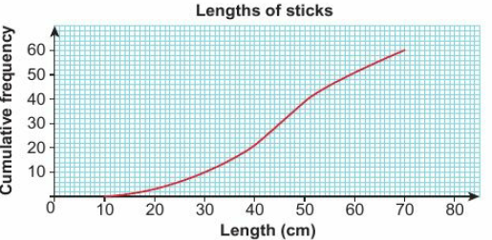
14 – Strengthen
Page 460
The cumulative frequency graph shows the lengths of sticks gathered to make a camp fire.
How many sticks were gathered?
What value is halfway up the x-axis?
Work out the median length,
Work out the lower and upper quartiles.
Work out the interquartile range.
Q3c hint – Draw a line across to the curve from the value you worked out in part b. Then go down to the x-axis.

Slide 84
14 – Strengthen
Page 460
The table shows the half-marathon times for 50 elite runners.
Draw a cumulative frequency table,
Draw a cumulative frequency graph,
Work out estimates for the median and quartiles.
Estimate how many runners took less than 72 minutes,
Estimate how many runners took more than 72 minutes.
Time, t (mins) | Frequency
65 ≤ x ≤ 68 | 4
68 < x ≤ 71 | 7
71 < x ≤ 74 | 17
74 < x ≤ 77 | 13
77 < x ≤ 80 | 9
Q4d hint – Draw a line up to the curve from 72 on the x-axis. Read across to the y-axis.
Q4e hint – Total frequency - the number less than 72 minutes

Slide 85
14 – Strengthen
Page 461
Draw a box plot for the data in Q4
Copy the x-axis scale from Q4
Mark on the median, lower and upper quartiles with vertical lines,
Complete the box with ends at the lower and upper quartiles.
Mark on the lowest possible and highest possible values from the frequency table and join with lines.
Q5 hint –

Slide 86
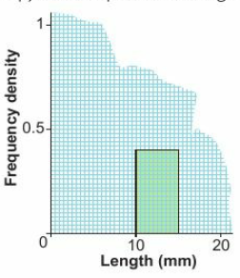
14 – Strengthen
Page 461
The lengths of some caterpillars are shown in the table.
For the class 5 < l ≤ 20, work out
the class width
the frequency density,
Copy and complete the table.
Copy and complete the histogram.
Length, l (mm) | Frequency | Class Width | Frequency Density
10 ≤ l ≤ 15 | 2 | 15 – 10 = 5 | 2 ÷ 5 = 0.4
15 < l ≤ 20 | 8 | 20 – 15 = ◻ | 8 ÷ ◻ = ◻
20 < l ≤ 25 | 15
25 < l ≤ 30 | 12
30 < l ≤ 35 | 5
Q6b hint –Divide the frequency by the class width
Q6c hint – Plot frequency density on the y-axis.

Slide 87
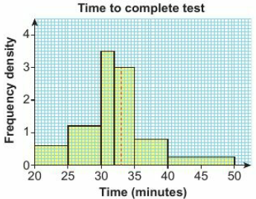
14 – Strengthen
Page 461
This histogram shows how long it took 44 students to complete a test.
How many students took between 25 and 30 minutes?
How many students took less than 30 minutes?
Estimate how many students took between 33 and 35 minutes. Estimate how many students took less than 33 minutes.
Q7a hint – Multiply the class width by the frequency density for that bar.
Q7b hint – Add the frequency for the 20 < t ≤ 25 bar to your answer to part a.
Q7c hint – Look at the class 33 < t ≤ 35, formed by the red dashed line.

Slide 88
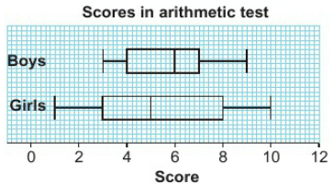
14 – Strengthen
Page 462
Comparing data
The box plots show the scores achieved by boys and girls in a test.
Copy and complete this table.
Copy and complete
The median for boys is _____________ than the median for girls.
______ have a smaller interquartile range than _______
 | Lower Quartile | Median | Upper Quartile | Interquartile range
Boys
Girls

Slide 89
14 – Strengthen
Page 462
STEM The stem-and-leaf diagram shows the masses, in kilograms, of female wild boars. Key: 6 | 0 represents 60 kg
How many boars are recorded in the stem-and-leaf diagram?
Workout $\frac{n+1}{4}$, $\frac{n+1}{2}$ and $\frac{3(n+1)}{4}$ .
Find these data values by counting from the first one.
Write down the median value,
Work out the interquartile range of the masses.
5 | 1 | 2 | 2 | 4 | 5 | 6
6 | 0 | 3 | 5 | 7 | 7 | 7 | 8 | 9
7 | 2 | 3 | 3 | 5 | 6 | 9
8 | 0 | 0 | 2
Q2c hint – n is the value you worked out in part a.
Q2d hint – The median value is the $\frac{n+1}{2}$th value.

Slide 90
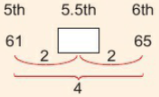
14 – Strengthen
Page 462
STEM The stem-and-leaf diagram shows the masses, in kilograms, of male wild boars. Key: 6 | 0 represents 60 kg
Find the median mass.
Find the lower and upper quartiles.
Find the interquartile range
Compare the data in Q2 and Q3.
Q2c hint – n = 21. The lower quartile us the $\frac{21+1}{4}$th = 5.5th value.
5 | 1 | 2 | 2 | 4 | 5 | 6
6 | 0 | 3 | 5 | 7 | 7 | 7 | 8 | 9
7 | 2 | 3 | 3 | 5 | 6 | 9
8 | 0 | 0 | 2
Q2d hint – Write sentences like the ones in Q1b.

Slide 91
14 – Extend
Page 463
STEM / Reasoning The speeds of 75 cheetahs are recorded in this table,
Draw an appropriate graph for the data,
Find an estimate for
i the median
ii the interquartile range.
Speed, s (mph) | Frequency
20 ≤ l ≤ 25 | 3
25 < l ≤ 30 | 8
30 < l ≤ 35 | 19
35 < l ≤ 40 | 21
40 < l ≤ 45 | 15
45 < l ≤ 50 | 9

Slide 92
14 – Extend
Page 463
The ratio of over-20s to under-20s in a snooker club is 5:3. A sample of 120 members is to be used in a survey. How many of each age group should be selected?
Reasoning In a building company there are 450 workers who operate cranes, 620 workers who operate forklift trucks and 130 workers who operate dump trucks. Explain how you would select a sample of 60 workers.
Q2 hint – Divide 120 in the same ratio as the population.

Slide 93
14 – Extend
Page 463
Real / Problem-solving A construction company owner wants to find out what his employees think of the new car park. Explain how he could select a sample of 80 people.
 | Builders | Electricians | Plumbers
Male | 120 | 40 | 20
Female | 70 | 36 | 34
Exam hint
Work out the total number of clients.
5 – Exam-Style Questions
A veterinary surgery has 130 clients who have pet rabbits, 150 who have guinea pigs, 75 who have hamsters and 60 who have gerbils.
One of the vets carries out a survey using a stratified sample of size 50.
How many clients should she sample from each group? (3 marks)
Describe how she might choose the clients from within
each group. (2 marks)

Slide 94
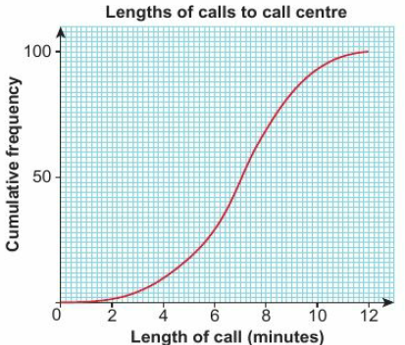
14 – Extend
Page 463
Real / Problem-solving The lengths of calls received by a call centre are recorded and shown on this graph,
Copy and complete: 10% of the calls were less than ◻ minutes.
Work out the limits between which the middle 80% of the data lies.
Q6a hint - Draw a line from 10% of the cumulative frequency across to the graph and down to the x-axis

Slide 95
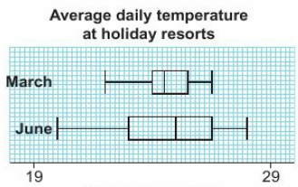
14 – Extend
Page 464
Real / Reasoning These box plots show the Average daily temperature in March and June at a holiday resort.
Give a reason why a holiday-maker might prefer to go to the resort in March,
Give a reason why they might prefer to go in June.

Slide 96
14 – Extend
Page 465
Reasoning This table records the results of a survey into how many peas there are in a pod.
Is the data discrete or continuous?
Copy and complete this cumulative frequency table.
Draw a set of axes with x going from 0 to 8 and y going from 0 to 100.
Plot the coordinate points (peas, cumulative frequency)
Peas | Number of Pods
3 | 7
4 | 11
5 | 18
6 | 34
7 | 20
8 | 10
Peas | Cumulative Frequency
≤ 3 | 7
≤ 4 | 18
≤ 5
≤ 6
≤ 7
≤ 8

Slide 97
14 – Extend
Page 465
Reasoning continued:
Join the points in a 'staircase' pattern going across and then up from each coordinate point to the next,
This diagram is called a cumulative frequency step polygon.
Discussion Why is it not appropriate to draw a smooth curve through the points for this data?
Find the median number of peas in a pod.
Peas | Number of Pods
3 | 7
4 | 11
5 | 18
6 | 34
7 | 20
8 | 10
Peas | Cumulative Frequency
≤ 3 | 7
≤ 4 | 18
≤ 5
≤ 6
≤ 7
≤ 8

Slide 98
14 – Extend
Page 465
The number of rabbits born in each of 120 litters is recorded in this table.
Draw a cumulative frequency table for this data,
Draw a cumulative frequency step polygon,
Write down the median number of rabbits in a litter,
Work out the interquartile range for number of rabbits in a litter.
Rabbits | Number of litters
2 | 8
3 | 15
4 | 23
5 | 41
6 | 25
7 | 8
Q9e hint –

Slide 99
14 – Extend
Page 465
Reasoning The time, in seconds, for 15 runners to complete a hurdles race is recorded: 13.5, 14.1, 14.2, 14.3, 14.5, 14.7, 14.7, 14.9, 15.0, 15.1, 15.2, 15.5, 15.7, 15.8, 28.6
Work out the median time taken.
Work out the lower quartile, upper quartile and interquartile range,
Work out 1.5 x interquartile range.
We can define an outlier as a data value which lies more than 1.5 x the interquartile range below the lower quartile or above the upper quartile. Use this definition to decide if any of the data points are outliers.
Discussion Assuming all of the runners are of a similar standard, what might account for the extreme value(s)?

Slide 100
14 – Extend
Page 465
Reasoning This box plot shows the ages of people at a birthday party
Write down the interquartile range.
Using the definition in Q10d, work out the range of ages that would not be considered outliers.
The second youngest person at the party was 9 years old and the second oldest person was 21. Write down the values of any outliers.
A box plot can be redrawn to show outliers. Outliers are marked with a cross and the ends of the whiskers are now drawn at the first value not considered an outlier,
Redraw the box plot above to show the outlier(s).

Slide 101
14 – Extend
Page 465
Problem-solving The table shows the times taken for players to complete a round of golf,
Draw a histogram for this data,
Players who took longer than 4 hours 20 minutes were given a two-shot penalty. Estimate the number of players who were given a penalty.
Time, t (hours) | Frequency
3 < t ≤ 3.5 | 7
3.5 < t ≤ 4 | 12
4 < t ≤ 4.5 | 18
4.5 < t ≤ 5 | 24
5 < t ≤ 5.5 | 15

Slide 102
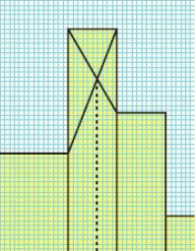
14 – Extend
Page 465
STEM / Reasoning The masses of 100 camels are given in this table.
Draw a histogram for this data,
Work out an estimate for the mean mass,
Work out an estimate for the median mass,
Write down the modal class,
An estimate for the modal value can be worked out from the histogram using the method shown in this extract from another histogram. What is the modal value shown in the extract?
Work out an estimate for the modal mass of the camels.
Mass, m (kg) | Frequency
300 ≤ t ≤ 500 | 8
500 < t ≤ 600 | 10
600 < t ≤ 700 | 15
700 < t ≤ 750 | 18
750 < t ≤ 800 | 36
800 < t ≤ 900 | 11
900 < t ≤ 1100 | 2
Q13f hint - Your value for the mode is only an estimate, as the histogram does not show individual data values.

Slide 103
14 – Extend
Page 466
STEM / Reasoning The lengths of 50 Barbour's seahorses are recorded in this table,
Draw a histogram for this data,
Work out an estimate for the mean length of the seahorses.
Work out an estimate for the median length of the seahorses.
Work out an estimate for the mode.
Length, x (cm) | Frequency
10 ≤ t ≤ 12 | 3
12 < t ≤ 13 | 8
13 < t ≤ 13.5 | 12
13.5 < t ≤ 14 | 10
14 < t ≤ 15 | 9
15 < t ≤ 17 | 8

Slide 104
14 – Extend
Page 466
14 – Knowledge Check
A population is the set of items that you are interested in. A census is a survey of the whole population A sample is a smaller number of items from the population. A sample of at least 10% is considered to be a good-sized sample. In order to reduce bias, the sample must represent the whole population. In a random sample each item has the same chance of being chosen. To select a simple random sample draw names from a hat, generate random numbers on a calculator or use a table of random numbers. A population may divide into groups such as age range or gender. These groups are called strata (singular stratum). In a stratified sample, the number of people taken from each group is proportional to the group size.
Mastery Lesson 14.1
Mastery Lesson 14.1
Mastery Lesson 14.1
Mastery Lesson 14.1
Mastery Lesson 14.1

Slide 105
14 – Extend
Page 467
14 – Knowledge Check
To estimate the size of the population N of an animal species: Capture and mark a sample size n. Recapture another sample of size M. Count the number marked (m). $\frac{n}{N}$ = $\frac{m}{M}$ so N = $\frac{n x M}{m}$ This is the capture-recapture method. A cumulative frequency table shows how many data values are less than or equal to the upper class boundary of each data class. A cumulative frequency diagram has data values on the x-axis and cumulative frequency on the x-axis. The median and quartiles can be estimated from the cumulative frequency diagram. For a set of n data values the estimate for the median is the $\frac{n}{2}$th value o the estimate for the lower quartile (LQ) is the $\frac{n}{4}$th value the estimate for the upper quartile (UQ) is the $\frac{3n}{4}$th value. the interquartile range (IQR) = UQ - LQ.
Mastery Lesson 14.2
Mastery Lesson 14.2
Mastery Lesson 14.2
Mastery Lesson 14.2

Slide 106
14 – Extend
Page 467
14 – Knowledge Check
For a set of n data values the lower quartile (LQ) is the $\frac{(n+1)}{4}$th value. the upper quartile (UQ) is the $\frac{3(n+1)}{4}$th value. A box plot, sometimes called a box-and-whisker diagram, displays a data set to show the median and quartiles. Comparative box plots are box plots for two different sets of data drawn on the same scale. A histogram is similar to a bar chart but is used to represent continuous data. In a histogram the area of the bar represents the frequency. The height of each bar is the frequency density. Frequency density = $\frac{frequency}{class width}$ The median and interquartile range are not affected by extreme values or outliers. When there are extreme values, the median and interquartile range should be used rather than the mean and range.
Mastery Lesson 14.3
Mastery Lesson 14.3
Mastery Lesson 14.4
Mastery Lesson 14.4
Mastery Lesson 14.6

Slide 107
14 – Extend
Page 467
14 – Knowledge Check
The interquartile range measures the spread of the middle 50% of the data. To describe a data set (or population) give a measure of average and a measure of spread. To compare data sets, compare a measure of average and a measure of spread. Choose A, B or C to complete each statement about statistics. In this unit, I did... A well B OK C not very well I think _____ is... A easy B OK C hard When I think about doing _____, I feel... A confident B OK C unsure Did you answer mostly As and Bs? Are you surprised by how you feel about ____? Why? Did you answer mostly Cs? Find the three questions in this unit that you found the hardest. Ask someone to explain them to you. Then complete the statements above again.
Mastery Lesson 14.6
Reflect

Slide 108
14 – Unit Test
Page 468
14 – Unit Test | Log how you did on your Student Progression Chart.
Reasoning A market research company wants to get the views of members of the public on new chocolate bars.
Give two reasons why a sample should be taken rather than a census. (2 marks)
They propose to take their sample from the school nearest to the company headquarters. Explain whether this will be a good sample. (1 mark)

Slide 109
14 – Unit Test
Page 468
The masses of 100 octopuses are shown in this table.
Draw a cumulative frequency diagram. (3 marks)
Estimate the median mass. (1 mark)
Find the interquartile range. (2 marks)
Estimate how many octopuses weigh more than 6.5 kg. (2 marks)
Mass, m (kg) | Frequency
3 ≤ m ≤ 4 | 4
4 < m ≤ 5 | 11
5 < m ≤ 6 | 15
6 < m ≤ 7 | 18
7 < m ≤ 8 | 23
8 < m ≤ 9 | 17
9 < m ≤ 10 | 12

Slide 110
14 – Unit Test
Page 468
Problem-solving The times taken by a group of men and a group of women to complete an obstacle course are shown in the box plots. Compare the two data sets. (3 marks)

Slide 111
14 – Unit Test
Page 468
The president of a dining society wants to get the opinions of the members on new menu choices. He decides to take a sample of 50 members. The age and gender profile of the society is given in this table.
Explain why a stratified sample should be taken, (3 marks)
How many males under 25 should be in the sample? (3 marks)
How many females aged between 26 and 35 should be in the sample? (3 marks)
The president lists each group of members alphabetically and numbers them He uses a random number table to work out whom to ask. Use the table below to write down the numbers of the females aged between 26 and 35 that will be surveyed. (2 marks)
 | 18-25 | 26-35 | 36-45 | 45+
Male | 9 | 25 | 54 | 30
Female | 12 | 30 | 45 | 35
04897974662531115764023402125561306

Slide 112
14 – Unit Test
Page 469
Reasoning The ages of 15 people in the cast for a show are 6, 15, 23, 18, 17, 9, 11, 32, 31, 14, 45, 25, 26, 26, 15
Draw a box plot. (3 marks)
Outliers are defined as being data points at least 1.5 x interquartile range above the upper quartile or below the lower quartile. Use this definition to work out if the data set contains outliers, (1 marks)
Explain, with a reason, whether these data points should be excluded. (1 marks)

Slide 113
14 – Unit Test
Page 469
Problem-solving The lengths of 150 dolphins are recorded in this table.
Draw a histogram. (3 marks)
Estimate the mean length of the dolphins, (3 marks)
Estimate the median length of the dolphins, (3 marks)
Estimate how many dolphins are over 3.25 m long, (3 marks)
Estimate the modal length. (3 marks)
Length, l (m) | Frequency
1.5 ≤ m ≤ 2.0 | 7
2.0 < m ≤ 2.5 | 19
2.5 < m ≤ 2.8 | 31
2.8 < m ≤ 3.0 | 52
3.0 < m ≤ 3.5 | 34
3.5 < m ≤ 5.0 | 7

Slide 114
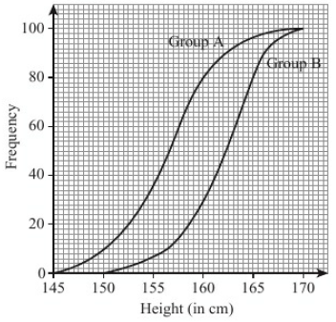
14 – Unit Test
Page 470
Sample student answer
What is good about the presentation of this graph?
Which of the values (upper/lower quartile, median) is incorrect, and how has this mistake happened?
Exam-Style Questions
The cumulative frequency graphs give information about the heights of two groups of children, group A and group B.
Compare the heights of the children in group A and the heights of the children in group B. (2 marks)
Nov 2013, Q1I, 5MB1H/01

Slide 115
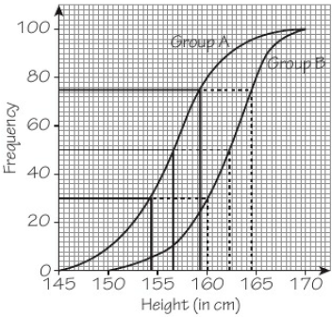
14 – Unit Test
Page 470
Student answer
A B Upper 159.5 164.5
Median 156.5 162.5
Lower 154.5 160
On average group B are taller, as shown by their median 162.5 compared to 156.5 for group A.
Group A has a larger interquartile range (5 compared to 4.5 for B) showing that their heights are more spread out.

